Slide 1




Slide 2





Slide 3




Slide 4

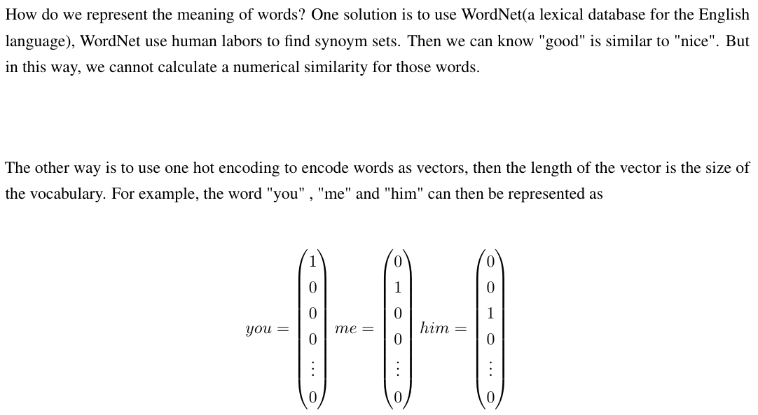

Slide 5





Slide 6

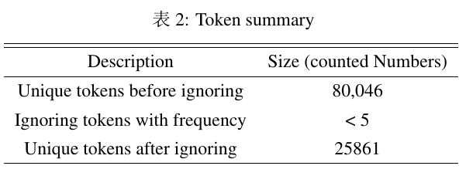
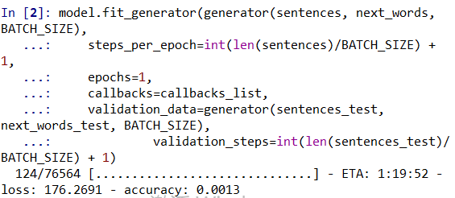
sentences.append( all_data[i: i + seq_length] )
x = np.zeros((len(sentences), SEQUENCE_LEN, len(tokens)), dtype=np.bool) y = np.zeros((len(sentences), len(words)), dtype=np.bool)

Slide 7
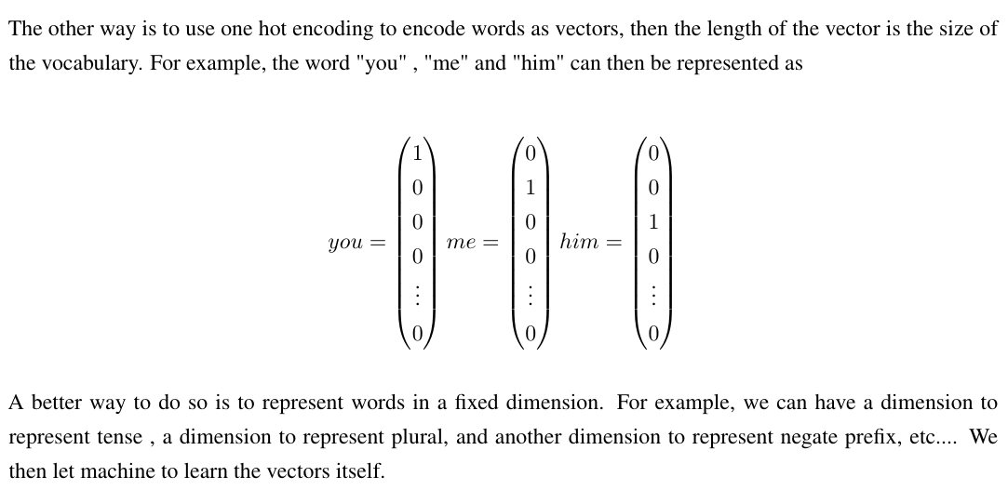

Slide 8


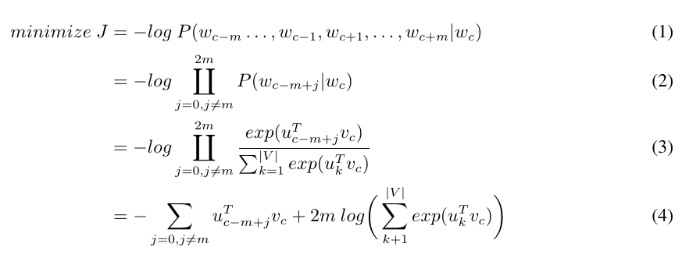

Slide 9
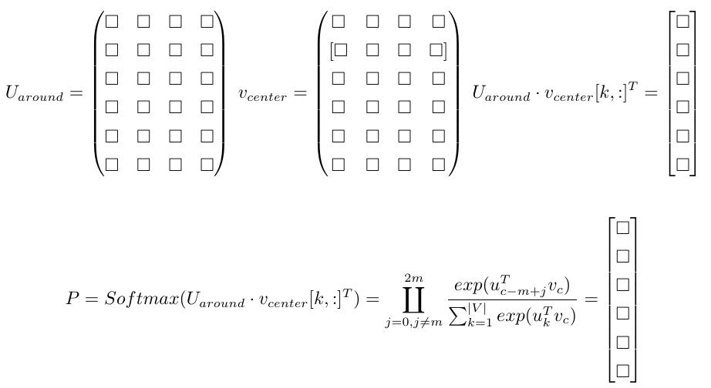

Slide 10
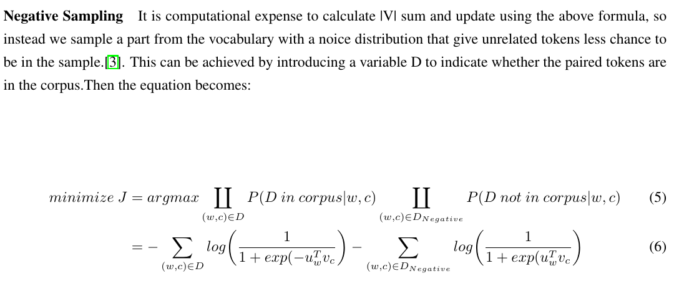

Slide 11

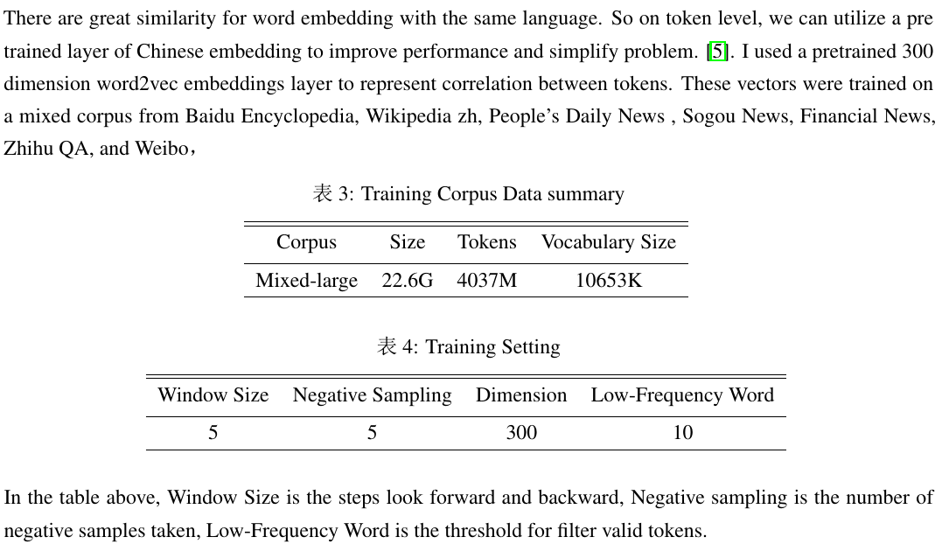

Slide 12



With pretrained Embedding layer I am able to train much faster.
Embedding size is 300, vocab_size is 352272
Epoch 3:
We still need to train more epoch to make the story have more sense

Slide 13
